Slide 1
Summer Adventure School Info Briefing
2024 Edition

Slide 2
We have had to change the location
We have changed the location of the School from Jindabyne to Camp Cottermouth in Canberra due to river water levels, bushfire & evacuation risks.
Adjustments have been made to prices.
Refunds will be issued for the difference.
  General participant: $775
  Assistant activity leader: $360
  Horse riding option: $200
We can offer an as good (or better!) experience than Jindabyne.
Cottermouth (and the surrounding areas) offers substantial advantages for our camp participants, including a huge range of activities and locations, as well as easier transport and equipment availability.
Location-specific activities such as Gravity MTB can’t be offered

Slide 3
What will we do at the school?
A Major Activity:
  Everyone can nominate either a bushwalking, white water, or cycling journey
  Three-day activity which will include instruction, planning, and the activity including overnight(s)
Minor Activities:
  Everyone can do up to 4 different minor activities over two days
  Options include canoeing, abseiling, climbing, pioneering, radio, and river crossing
  Horse riding is offered at an additional cost
Common Activities:
  Everyone will spend a day bushwalking with skills development, consolidation, and checks ending at Namadgi for sunset
  SIAs are possible:
    STEM – radio
    Outdoors – horse riding
    Personal Development – maybe coming on the school
  Radio could include getting a VHF licence

Slide 4
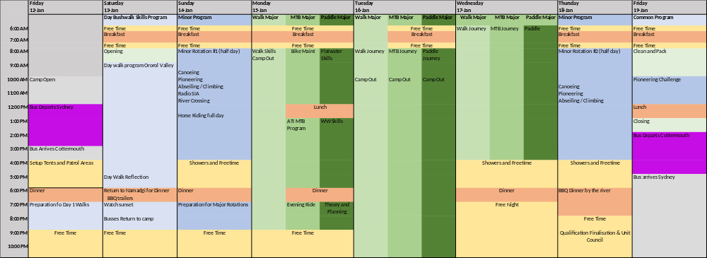
The Program
The program may change due to weather and other circumstances
  You will be sleeping in tents for the entire school
  Each day starts at 0600
  Lights out at 2200
We will operate in Patrols of 5 to 6
  Each patrol will have a mentoring Guide
  Each patrol will have an Assistant Guide and often a Youth Patrol Leader who will run the patrol
  Patrols will have duties including helping in the kitchen

Slide 5
What can I achieve?
Everyone can achieve a Certificate II in Outdoor Recreation
But you need to do some pre-work.
All youth members can achieve OAS Stage progression or achieve I statements
Youth members with a Certificate II can achieve an Assistant Guide appointment.
Some members may achieve Guide Qualifications and a Certificate III and we will develop plans for others on achieving the Certificate III.
Can be used for Duke of Edinburgh Gold Residential, skills or practice journey
And most importantly, everyone will feel challenged and have a lot of fun!
To achieve, you need to build and demonstrate knowledge and skills – it is more than attending! Paperwork is required during the school, and online training is required before the school. You must have and keep a logbook.

Slide 6

How will I get there?
We will provide coach transport from Sydney, departing Hornsby and stopping at selected hubs. Please car-pool to/from hubs where possible.
We want all participants from outside the Canberra region to travel on the bus to manage the risk of fatigue after the school.
Location | Departure Date & Time | Return Date & Time
Hornsby | 12 Jan @ 11:00 | 19 Jan @ 18:00
Parramatta | 12 Jan @ 11:30 | 19 Jan @ 17:30
Campbelltown | 12 Jan @ 12:00 | 19 Jan @ 17:00
Sutton’s Forest | 12 Jan @ 13:00 | 19 Jan @ 16:00
Camp Cottermouth | 12 Jan @ 15:30 | Depart 19 Jan @ 14:00
We will pay for bus tickets from Armidale and Leeton to and from Cottermouth
Interstate: Make your own way to Canberra Airport. We will pick you up.
Those around the Canberra area may drive themselves to Camp Cottermouth. We expect you to arrive by 1500 on 12 Jan. Parking is available on-site.
Notes:
48 seat coach
Hubs will likely be railway stations or similar
Suttons Forrest Servo
Local shuttles to move around

Slide 7
Who are the leaders?
Paddling – Mic Doyle
Bushwalking – Josh Hackett
Cycling – Rose Stevens
Transport – Tim Uidam
Radio – David Uzzel Jr
Qualifications – Dave Noble & Sally-Anne Luxton
Welfare – Tim Uidam
Camp 2IC – Tony Cowcher
Camp Chief – Kenton Jurgs
Let’s hear from some of them about what you can expect

Slide 8
What should I bring?
A gear list will be provided (attached)
  Do not bring valuable items. You do need your phone with GPS, data and other applications.
  Do not bring cotton clothing for activities: If it gets wet, you will get cold.
  Have clothing that layers: fewer thinner garments rather than one big thick one.
  Bring any medication packaged and with written instructions.
  Provide any care and support plans to Welfare.
Everything must be packed and fit inside 3 bags:
  ~110L Jamboree style bag (main luggage)
  ~60L hiking pack/backpack for overnight activities
  ~20L Backpack/Day-pack for day activities
Water Activities
  Paddle, PFD and helmet will be provided.
  Water shoes must be enclosed and stay on your feet. No thongs!
  The water will be cold: bring thermal water gear.
Cycling:
  Bikes, bike packing, and safety equipment will be provided. You may BYO Helmet if it’s safe and compliant.
  If you have a bike and you want to bring it, reach out to Rose Stevens (see contact list page).
  We will want to see a photo of the bike and see your maintenance log.
  You will need to get it to Hurstville by 11 January – no room on the bus.
  You will need to carry your sleeping gear (tent, mat and bag) on the bike: make sure it is light!

Slide 9
Camping & Power
You will be camping in a tent for the entire period.
  You can bring a single tent for everything, or you can choose to bring a 2nd tent to leave at Camp while you’re out adventuring in your hike tent.
  Everything must still fit into your luggage bags.
You will be camping by patrol (patrols are organised around major activities).
Tents may be shared within the patrols. Normal Scouts NSW camping rules apply: No sharing of tests between males and females, or by adults and youth. That means that Rovers can’t share with Venturers or Scouts.
Temperatures in Canberra in January are expected to be between 14 and 28 degrees. You should have sleeping bags down to about 6 degrees. Expect rain.
Feel free to bring any stretchers or comforts from home, as long as they fit into your bags.
Power, Charging & Mobile Phones
Bring your own USB battery bank as your main power source.
  Recommended minimum 10,000mAh. No maximum limit.
  You must also supply a suitable charging cable. USB-A or USB-C is preferred.
  Make sure it has your name on the charger and the cable!
Leaders will charge your USB battery banks during the day; You charge your phone overnight.
We will not take responsibility for charging mobile phones – Battery banks only.
Medical devices, e.g. CPAP machines: As above.
Please supply your own power source for your device. We can recharge during the day.

Slide 10
What else should I bring?
Paperwork!
Your Adventurous Activities Log Book
  Link to Logbook Template
  Any evidence of activities you’d like the assessors to review.
  Digital photos are fine, we just need to see them somehow.
Your current OAS progressions, such as:
  Your OAS book, or
  A report from Terrain, or
  A report from your Scout Leader
Any SIA submissions that you’d like the Unit Council to review
Any Duke of Ed. activities that you’d like the assessors to review
We will provide a link to a SharePoint to share any evidence with us
And please bring it with you to Camp
Self Catering
  We will cater for all dietary needs that you tell us about, but feel free to self-cater your own meals if you feel that’s easier for you. If you do, you must let us know.

Slide 11
What training do I have to do before I arrive?
Certificate II Online Training
Certificate III Online Training
(Assumes Certificate II already held)
Activity Specific
Most courses have a pre-test so if you have the knowledge already, you can move quickly through
https://training.scouts.com.au/curriculums/page-for-adventurous-activities
Complete:
  Level 1 Common Core
  All 5 online courses
  Certificate II Outdoor Recreation
  All 4 online courses
https://training.scouts.com.au/curriculums/page-for-adventurous-activities
Complete:
  Scouting Adventure
  All 13 online courses
  Common Core B2
  Coordinating Emergency Response
https://training.scouts.com.au/curriculums/page-for-adventurous-activities
Complete:
  L1 Bushwalking
  L1 Canoeing/Kayaking
  L1 Abseiling

Slide 12
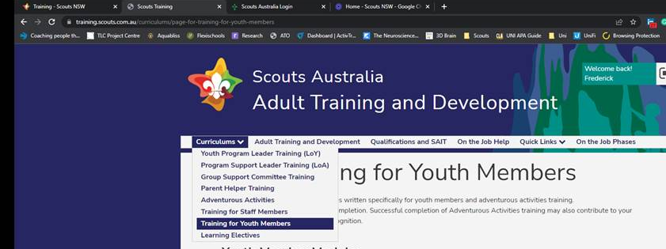
Online Learning
https://training.scouts.com.au/curriculums/page-for-training-for-youth-members
Username: Your Scout Membership Number
Initial Password: Date of birth in reverse order (e.g., 20080313 for 13th March 2008).
Video Tutorial: How to Log In
Select the “Curriculums” dropdown tab.
Choose “Training for Youth Members”.
Video Tutorial:
How to access Training Modules
Swift progression if you already have the required knowledge.
Most courses have with a pre-test. If you pass, the module is complete.

Slide 13
What are the camp rules and expectations?
No computer games or devices
Around 60 minutes of paperwork is expected each evening
The camp is achievement-focused and requires effort
We will establish a Youth Unit Council

Slide 14
Next steps
Finalise your enrolment including payment, getting all the medical, dietary and other information correct and providing a logbook with your recent activities (the NSW Template Logbook will be provided).
Let us know if you would like to obtain a VHF radio licence by COB 14 Dec. Email: david.e.uzzell@nsw.scouts.com.au
Cyclists: let us know your leg length, height and head circumference, please. Let us know if you want to bring your bike.
Email: rose.stevens@nsw.scouts.com.au
Do your online learning (getting it down before the camp means you have less to do in the evenings).
Check your gear: if you don’t have something, talk to your Group.

Slide 15
Contacts
Name | Role | Email | Mobile
Kenton Jurgs | Camp Chief | Kenton.Jurgs@nsw.scouts.com.au | 0417 407 422
Josh Hackett | Bushwalking Guide | Josh.Hackett@nsw.scouts.com.au
Mic Doyle | Paddling Guide | Mic.Doyle@nsw.scouts.com.au | 0414 905 923
Rose Stevens | Cycling Guide | Rose.Stevens@nsw.scouts.com.au | 0432 321 165
Elvira Currie | Horse Riding | Elvira.Currie@nsw.scout.com.au
Tim Uidam | Camp Welfare | Tim.Uidam@nsw.scouts.com.au | 0414 405 445
Sallyanne Luxton | National Qualifications | Sallyanne.Luxton@nsw.scouts.com.au
David Uzzel Jr | Radio | david.e.uzzell@nsw.scouts.com.au

Slide 16
Questions?

